Slide 1

Project 2 Brazilian E-Commerce Public Dataset by Olist
https://www.kaggle.com/olistbr/brazilian-ecommerce/code

Slide 2
Background
Olist, a Brazilian e-commerce marketplace integrator
Is an online e-commerce site aggregation platform designed to facilitate direct sales on e-commerce sites of Brazil
The company's platform connects entrepreneurs with major online retailers and allows shopkeepers to advertise and sell in the marketplaces without complication, enabling retail companies to reach out to the international marketplaces, improve the shopping experience and modify their purchasing behavior
Olist connects small businesses from all over Brazil to channels without hassle and with a single contract. Those merchants are able to sell their products through the Olist Store and ship them directly to the customers using Olist logistics partners

Slide 3
Business Question
Customer Segmentation
How should we priorities customers?
What should we do to bring in more sales?
Seller Segmentation
To create a better e-commerce platform for user to buy or sell product?
Do we need to remove seller who are inactive in the platform?

Slide 4
Data Description
Order_items Data
1 | order_id
2 | order_item_id
3 | product_id
4 | seller_id
5 | shipping_limit_date
6 | price
7 | freight_value
Order Data
1 | order_id
2 | customer_id
3 | order_status
4 | order_purchase_timestamp
5 | order_approved_at
6 | order_delivered_carrier_date
7 | order_delivered_customer_date
8 | order_estimated_delivery_date
Customer Data
1 | customer_id
2 | customer_unique_id
3 | customer_zip_code_prefix
4 | customer_city
5 | customer_state
Payment_detail Data
1 | order_id
2 | payment_sequential
3 | payment_type
4 | payment_installments
5 | payment_value
Products Data
1 | product_id
2 | product_category_name
3 | product_name_lenght
4 | product_description_lenght
5 | product_photos_qty
6 | product_weight_g
7 | product_length_cm
8 | product_height_cm
9 | product_width_cm
Review Data
1 | review_id
2 | order_id
3 | review_score
4 | review_comment_title
5 | review_comment_message
6 | review_creation_date
7 | review_answer_timestamp
Geolocation Data
1 | geolocation_zip_code_prefix
2 | geolocation_lat
3 | geolocation_lng
4 | geolocation_city
5 | geolocation_state
Seller Data
1 | seller_id
2 | seller_zip_code_prefix
3 | seller_city
4 | seller_state

Slide 5
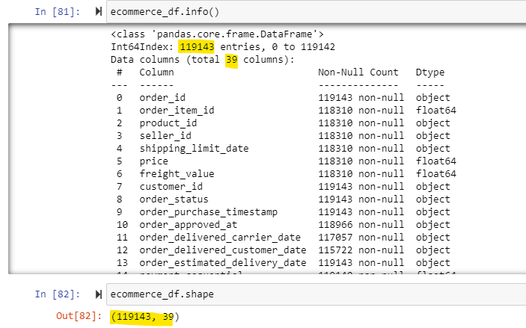
Data Description
Data date range: October 2016 to August 2018
Data consist of 119143 rows and 39 columns
Drop NaN value
Drop 11 columns which I will not use

Slide 6
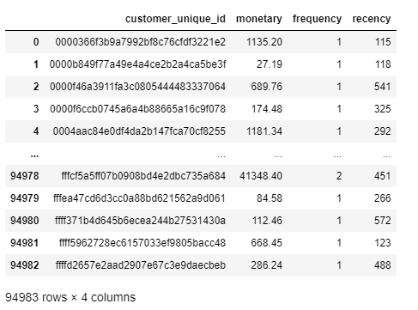
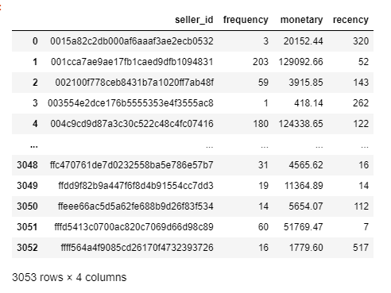
Data Description
Add column to separate customer purchase the months and years
Add column to calculate Recency, Monetary and Frequency
Customer RFM data table
Seller RFM data table

Slide 7
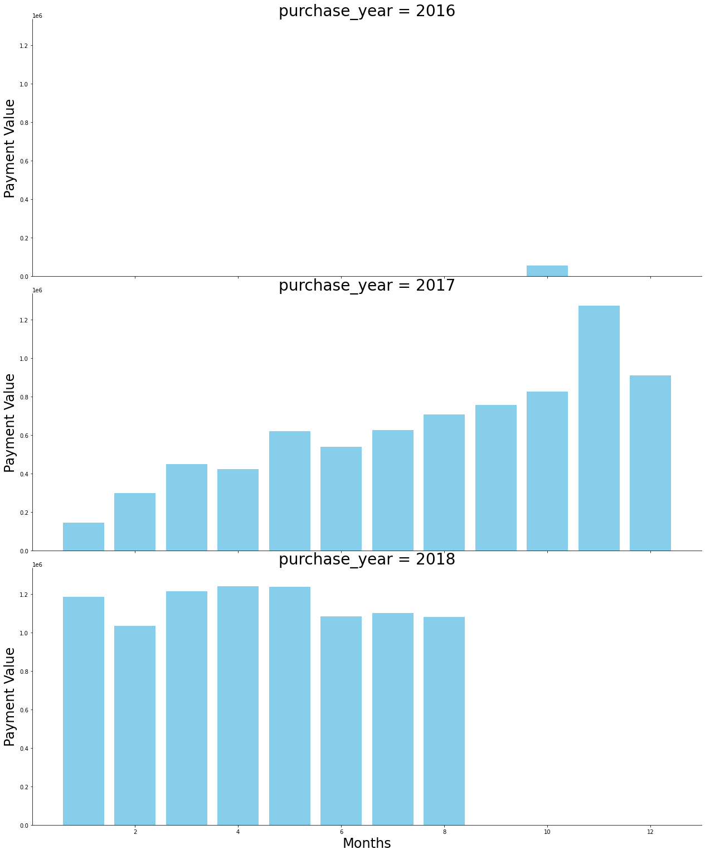
Growing trend

Slide 8
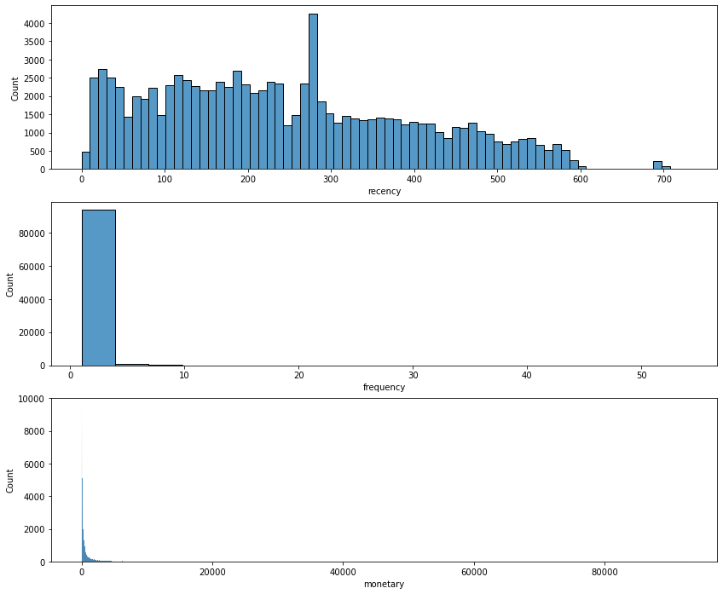
Customer Segmentation
Using RFM analysis

Slide 9
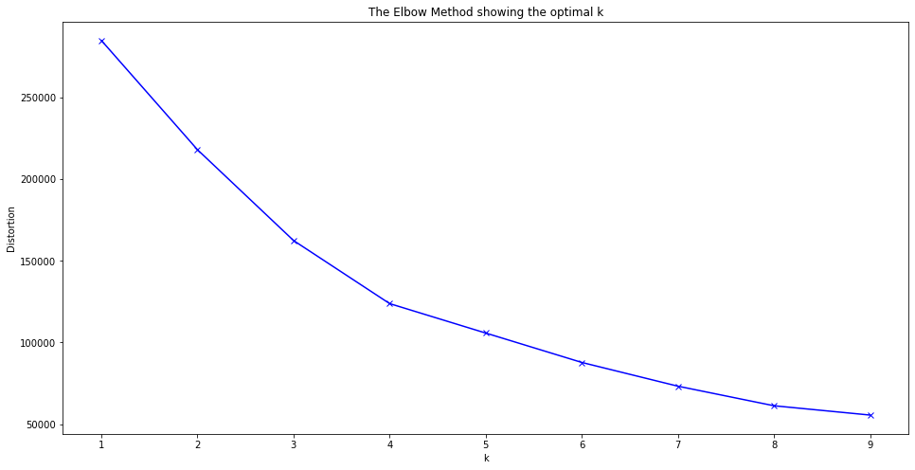
Customer K Means
Optimal K value is 4

Slide 10
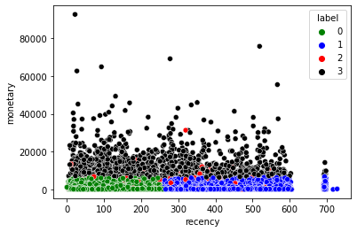
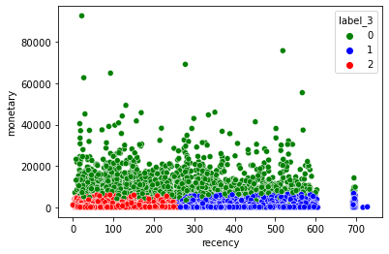
Customer K Means
N_Cluster = 4
N_Cluster = 3
N = 3 Cluster separate the data better
The data does not show that the more you purchases online is equal to the more you spend
Can focus build better customer relationship to ensure that the platform uphold a standard of trust.

Slide 11
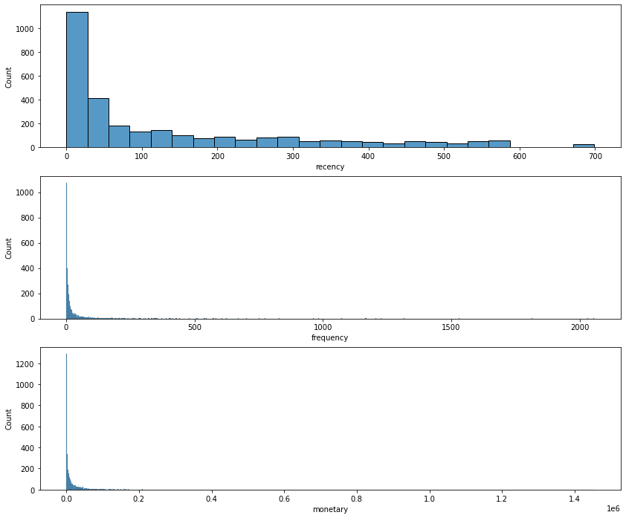
Seller Segmentation
Using RFM analysis

Slide 12

Seller Segmentation: K Mean
Optimal K value is 4

Slide 13
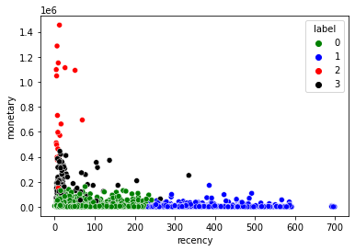
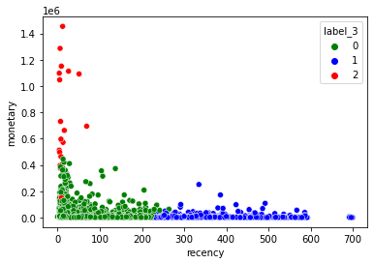
Seller Segmentation: K Mean
N_Cluster = 4
N_Cluster = 3
N = 3 Cluster separate the data better
The data does not show that the more you purchases online is equal to the more you spend
Can focus build better customer relationship to ensure that the platform uphold a standard of trust.

Slide 14
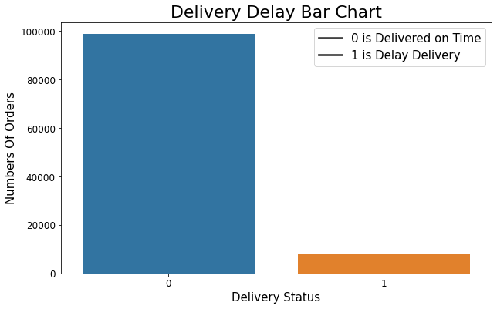
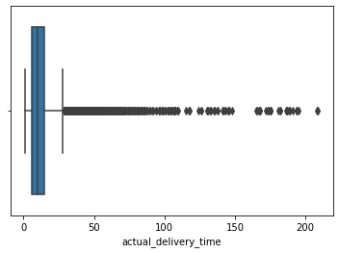
Seller Segmentation: Delivery Status

Slide 15
Question
Business question?
Predict future sales, are there any trends?
Popular/prefered products that are purchased through ecommerce.
Which cities have the most customers and are delivery a concern to buyers?

Slide 16
Data question?
Does the price of the column affect the sale.
Which seller can we keep,

Slide 17
Things to do
Plot the seller graph that we seek which seller have the most sales
Plot the products category and see which

Slide 18
New dataframe varible to keep all these info. Geolocation merging Coding
Merging all the file except geolocation file
merge_df = pd.merge(order_items, orders, left_on='order_id', right_on='order_id', how='left')
merge_df = pd.merge(merge_df, customers[['customer_id', 'customer_zip_code_prefix']], how='left',left_on='customer_id',right_on='customer_id')
geo = geolocation.groupby('geolocation_zip_code_prefix').mean().reset_index()
merge_df = pd.merge(merge_df, geo[['geolocation_zip_code_prefix', 'geolocation_lat', 'geolocation_lng']], how='left', left_on='seller_zip_code_prefix', right_on='geolocation_zip_code_prefix').rename(columns={'geolocation_lat': 'seller_lat', 'geolocation_lng': 'seller_lon'})
merge_df = pd.merge(merge_df, geo[['geolocation_zip_code_prefix', 'geolocation_lat', 'geolocation_lng']], how='inner', left_on='customer_zip_code_prefix', right_on='geolocation_zip_code_prefix').rename(columns={'geolocation_lat': 'customer_lat', 'geolocation_lng': 'customer_lon'})

Slide 19
Adding column
merge_df['product_volume_cm3']=merge_df.product_length_cm * merge_df.product_height_cm * merge_df.product_width_cm
merge_df.order_delivered_customer_date = pd.to_datetime(merge_df.order_delivered_customer_date)
merge_df.order_delivered_carrier_date = pd.to_datetime(merge_df.order_delivered_carrier_date)
merge_df.order_purchase_timestamp = pd.to_datetime(merge_df.order_purchase_timestamp)
merge_df.order_estimated_delivery_date = pd.to_datetime(merge_df.order_estimated_delivery_date)

Slide 20
Convert the columns into specifics timeframe
merge_df['purchase_month']=merge_df.order_purchase_timestamp.dt.month
merge_df['purchase_day_of_week']=merge_df.order_purchase_timestamp.dt.day_of_week
merge_df['actual_delivery_time']=(merge_df.order_delivered_customer_date-merge_df.order_purchase_timestamp).dt.days
merge_df['carrier_delivery_time']=(merge_df.order_delivered_carrier_date-merge_df.order_purchase_timestamp).dt.days
merge_df['estimated_delivery_time']=(merge_df.order_estimated_delivery_date-merge_df.order_purchase_timestamp).dt.days
merge_df['distance'] = merge_df.apply( lambda row: haversine_distance( row['seller_lat'], row['seller_lon'], row['customer_lat'], row['customer_lon'], ), axis=1, )

Slide 21
Feature selection
Correlation heatmap
sns.heatmap(merge_df[merge_df.columns[::-1]].corr(), cmap=sns.diverging_palette(20, 220, n=200), annot=True, mask=mask, center = 0, )
plt.title("Heatmap of all the Features", fontsize = 30)
Target (X) = 'estimated_delivery_time'
features (y)= ['freight_value', 'product_volume_cm3', 'product_weight_g', #'purchase_day_of_week', #'price', #'estimated_delivery_time', 'carrier_delivery_time', 'distance' ]

Slide 22
Set up model
X = merge_df[features] y = merge_df[target]
X_data = StandardScaler().fit_transform(X)
X_train, X_test, y_train, y_test = train_test_split(X_data, y, test_size=0.2, random_state = 14)
models = [ ['Lasso: ', Lasso()], ['Ridge: ', Ridge()], ['KNeighborsRegressor: ', neighbors.KNeighborsRegressor()], ['RandomForest ',RandomForestRegressor()], ['ExtraTreeRegressor :',ExtraTreesRegressor()], ['GradientBoostingRegressor: ', GradientBoostingRegressor()] , ['XGBoost: ', XGBRegressor()] , #['MLPRegressor: ', MLPRegressor( activation='relu', solver='adam',learning_rate='adaptive',max_iter=10000,learning_rate_init=0.01,alpha=0.01)] ]
model_data = [] for name,curr_model in models :
curr_model_data = {}
curr_model.random_state = 100
curr_model_data["Name"] = name
start = time.time()
curr_model.fit(X_train,y_train)
end = time.time()
curr_model_data["Train_Time"] = end - start
curr_model_data["Train_R2_Score"] = metrics.r2_score(y_train,curr_model.predict(X_train))
curr_model_data["Test_R2_Score"] = metrics.r2_score(y_test,curr_model.predict(X_test))
curr_model_data["Test_RMSE"] = sqrt(mean_squared_error(y_test,curr_model.predict(X_test)))/100 model_data.append(curr_model_data)
model_scores = pd.DataFrame(model_data) model_scores

Slide 23
Plot graph
model_scores.plot(x="Name", y=['Train_R2_Score', 'Test_R2_Score', 'Test_RMSE'], kind="bar" , title = 'R2 Score Results' , figsize= (10,8)) ;

Slide 24
Regressor model
regressor = RandomForestRegressor(n_estimators=200, random_state=0) regressor.fit(X_train, y_train) y_pred = regressor.predict(X_test)
print("Random Forest Regressor's Mean Absolute Error: " + str(mean_absolute_error(y_pred, y_test))) y.describe()

Slide 25
Learning curve
from sklearn.model_selection import ShuffleSplit from sklearn.model_selection import learning_curve
cv = ShuffleSplit(n_splits=100, test_size=0.2, random_state=0)
estimator = RandomForestRegressor() train_sizes, train_scores, test_scores, fit_times, _ = learning_curve(estimator,X_train,pd.Series.ravel(y_train), cv=cv, n_jobs=4,
train_sizes=np.linspace(.1, 1.0, 5), return_times=True)

Slide 26
Learning curve set up
_, axes = plt.subplots(1, 3, figsize=(20, 5))
train_scores_mean = np.mean(train_scores, axis=1)
train_scores_std = np.std(train_scores, axis=1)
test_scores_mean = np.mean(test_scores, axis=1)
test_scores_std = np.std(test_scores, axis=1)
fit_times_mean = np.mean(fit_times, axis=1)
fit_times_std = np.std(fit_times, axis=1)

Slide 27
Plot learning curve
axes[0].grid() axes[0].fill_between(train_sizes, train_scores_mean - train_scores_std, train_scores_mean + train_scores_std, alpha=0.1, color="r")
axes[0].fill_between(train_sizes, test_scores_mean - test_scores_std, test_scores_mean + test_scores_std, alpha=0.1, color="g")
axes[0].plot(train_sizes, train_scores_mean, 'o-', color="r", label="Training score")
axes[0].plot(train_sizes, test_scores_mean, 'o-', color="g", label="Cross-validation score")
axes[0].legend(loc="best")

Slide 28
Plot learning curve
# Plot n_samples vs fit_times
axes[1].grid() axes[1].plot(train_sizes, fit_times_mean, 'o-')
axes[1].fill_between(train_sizes, fit_times_mean - fit_times_std, fit_times_mean + fit_times_std, alpha=0.1)
axes[1].set_xlabel("Training examples")
axes[1].set_ylabel("fit_times")
axes[1].set_title("Scalability of the model")

Slide 29
Plot learning curve
# Plot fit_time vs score
axes[2].grid()
axes[2].plot(fit_times_mean, test_scores_mean, 'o-')
axes[2].fill_between(fit_times_mean, test_scores_mean - test_scores_std, test_scores_mean + test_scores_std, alpha=0.1)
axes[2].set_xlabel("fit_times")
axes[2].set_ylabel("Score")
axes[2].set_title("Performance of the model")

